Slide 1

Unit 1 Greetings
问好

Slide 2
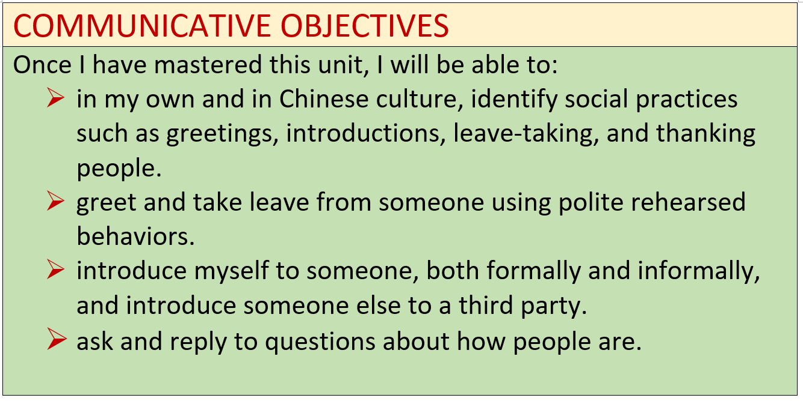

Slide 3
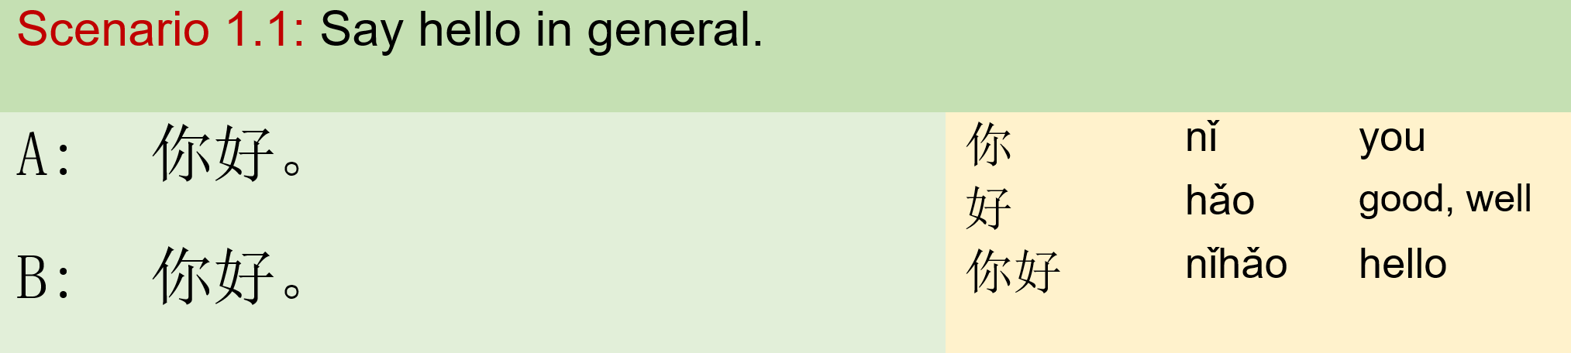

Module I: Say Hello 模块一：你好

Slide 4
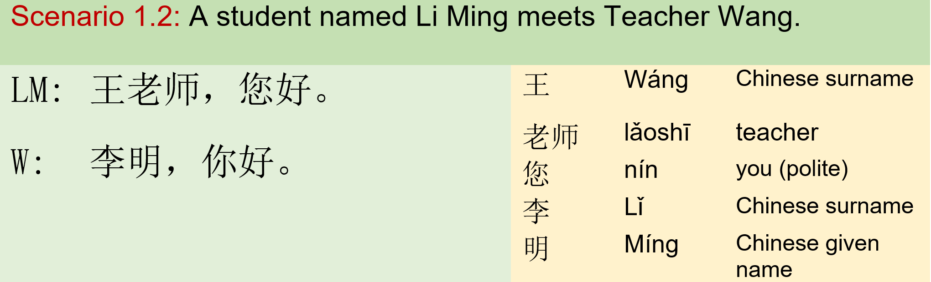
Module I: Say Hello 模块一：你好

Slide 5
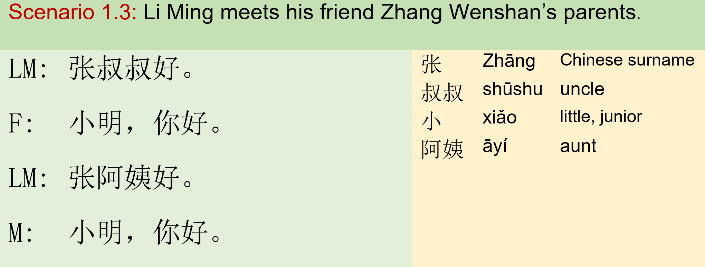
Module I: Say Hello 模块一：你好

Slide 6
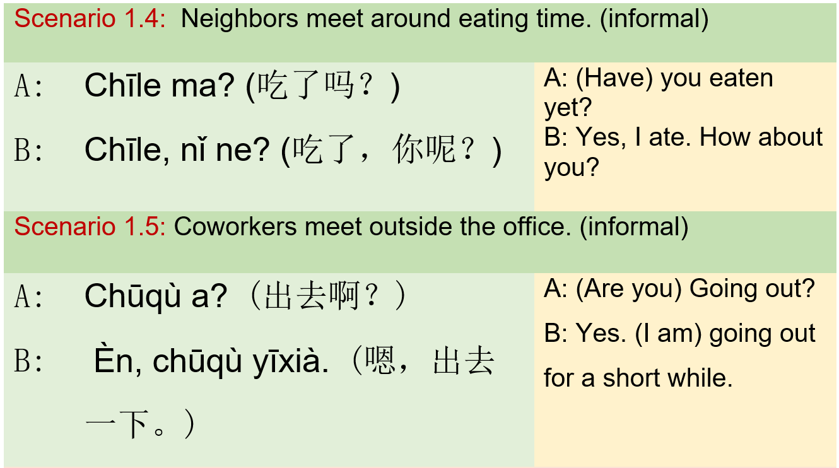
Module I: Say Hello 模块一：你好

Slide 7
Exercise
Drill:
1. Surname+Title 张 老师 李 + 叔叔 王 阿姨 2. 小+Surname/given name 张 小 + 李 王 明
Communication:
Each student uses a post-it sticker to write down a form of address, such as 阿姨，小王. Students walk around to say hello to each other, formally and informally.

Slide 8
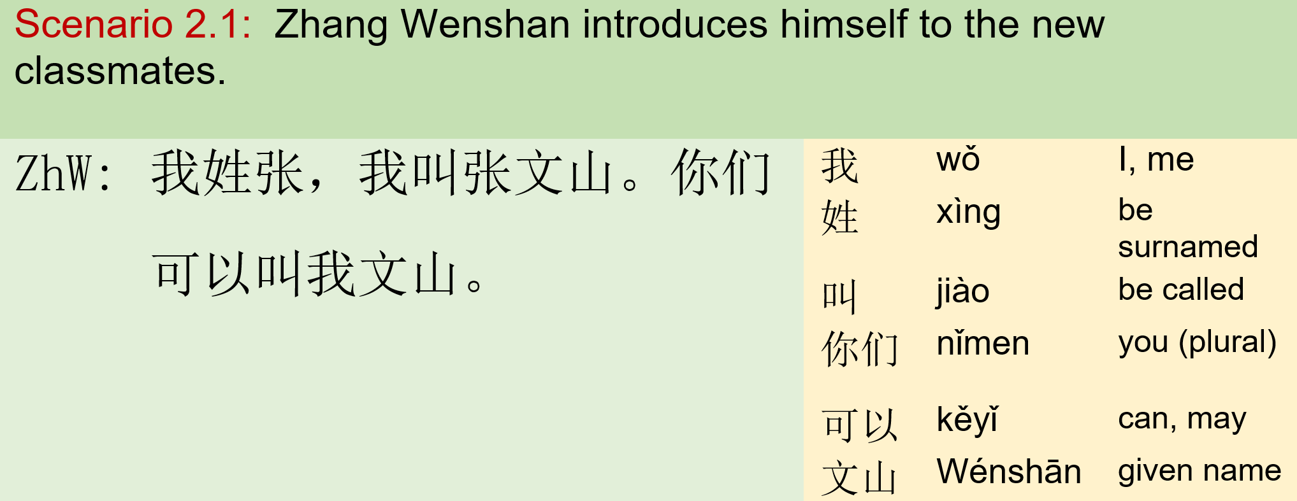
Module II: Introductions 模块二：介绍

Slide 9
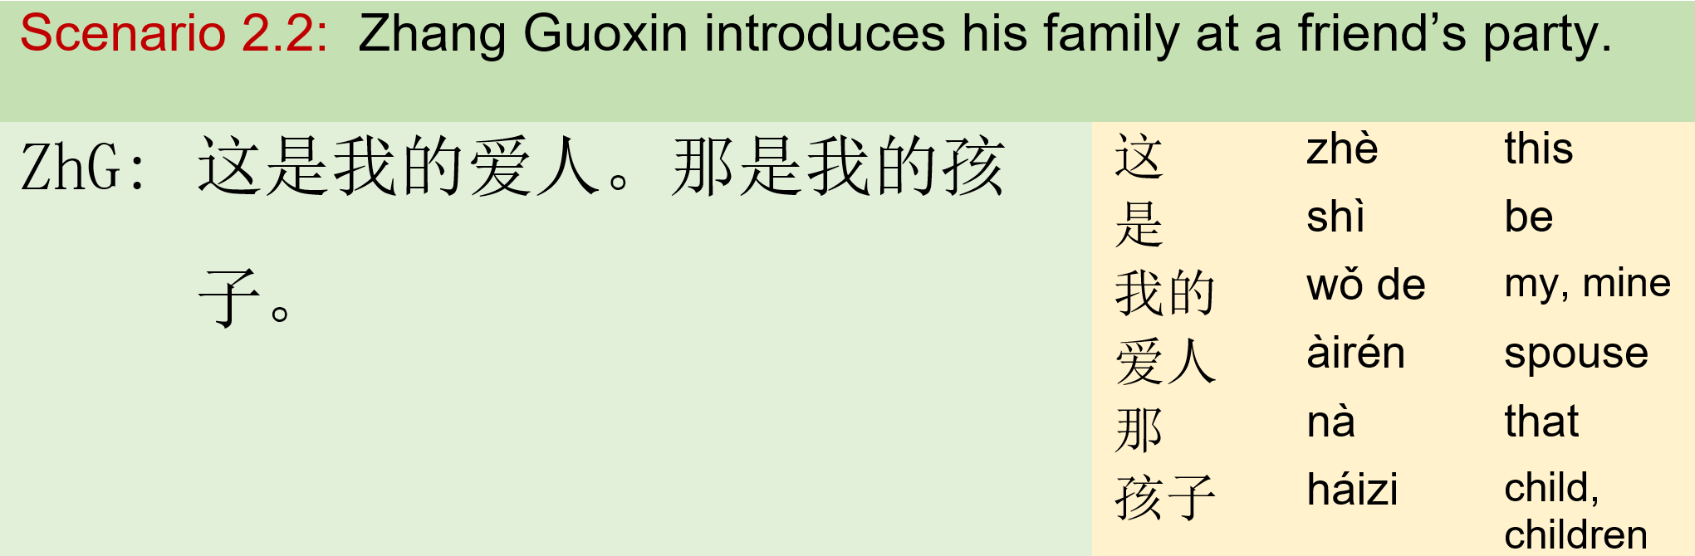
Module II: Introductions 模块二：介绍

Slide 10
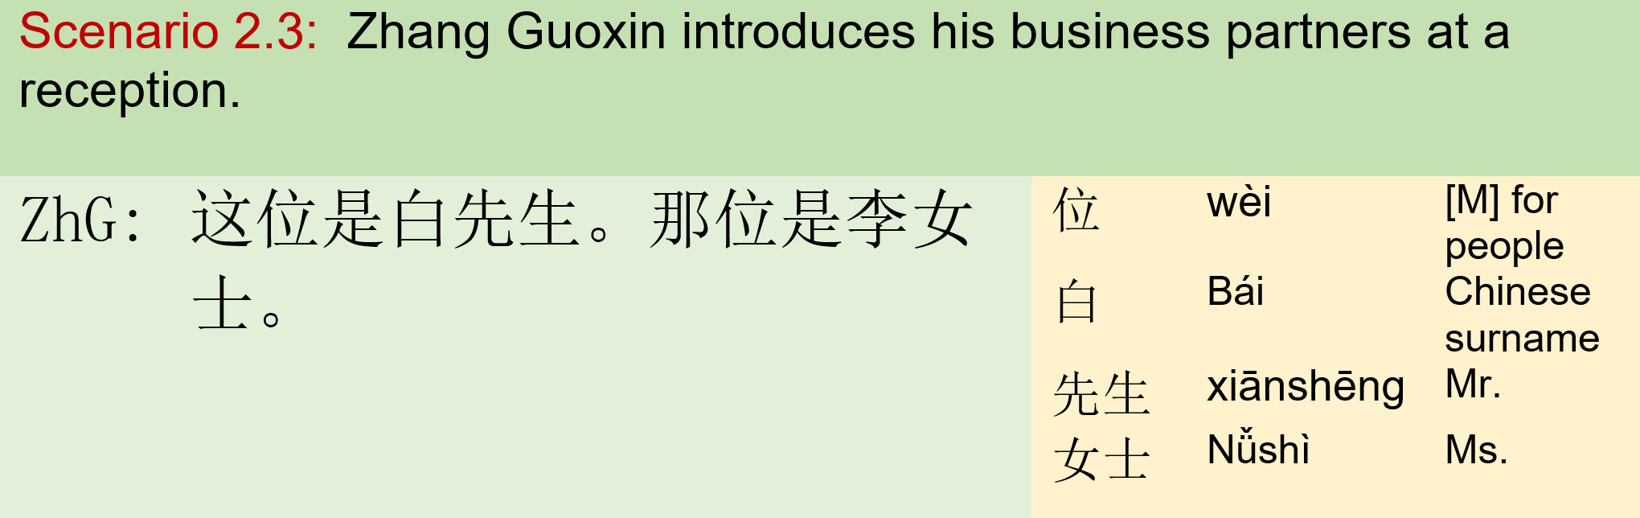
Module II: Introductions 模块二：介绍

Slide 11
Exercise
Drill:
 |  | 王
1. 我姓 | + | 张
 |  | 李
 |  | 白
 |  | 张阿姨
2.你可以 叫我 | + | 王叔叔 白叔叔
 |  | 小李
 |  | 小王
Communication:
Each student uses a post-it sticker to write down a form of address, like 张阿姨，小王. Students walk around to introduce themselves to others.

Slide 12
Exercise
Communication:
Each student uses a post-it sticker to write down a form of address, like 张阿姨，小王. Three students group up to practice introduce one person to the third party.
Drill:
 | 张阿姨
 | 李叔叔
3. 这（位）是 + | 张文山
 | 王老师
 | 白先生
 | 李女士
 | 我们的老师
 | 我的爱人
 | 我的孩子
 | 小王

Slide 13
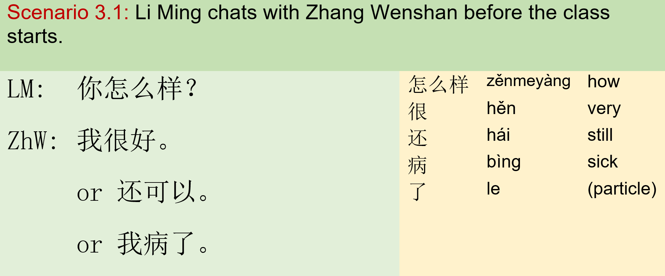
Module III: Greetings 模块三：寒暄

Slide 14
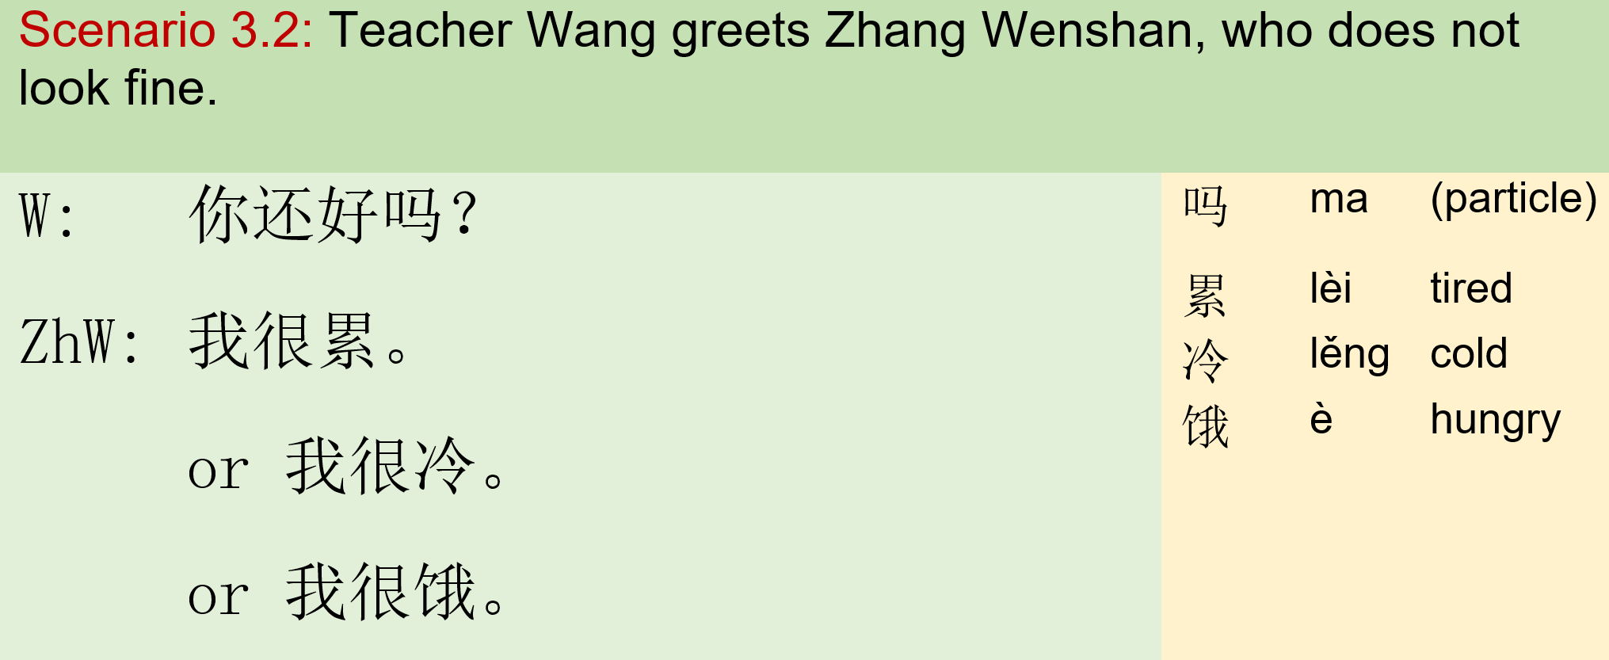
Module III: Greetings 模块三：寒暄

Slide 15
Exercise
Drill
A: 你怎么样？ | /你还好吗？
 | 很好
 | 很累
B: 我 + | 很饿
 | 很冷
 | 还可以
 | 病了
Communication:
Each student uses a post-it sticker to write down one status of feelings, such as 很好，还可以. Students walk around to ask each other and answer how they feel.

Slide 16
Exercise
Drill:
吗：a final particle, is used transform statements into questions. The pattern is: statement + 吗 你好 吗？(lit. Are you still doing Okay？)
这是白先生。 — |  | 这是白先生吗？
我姓李。 — |  | 你姓李吗？
我是李叔叔。 — |  | 你是李叔叔吗？
我很饿。 — |  | 你（很）饿吗？
我很冷。 — |  | 你（很）冷吗？

Slide 17
Exercise
很：an adverb. In Chinese, an adjective can be used as a predicate without being preceded by the verb 是（shì ，to be）The pattern is: Subject + adverbial modifier + adj. 我 很 累。（Lit. I’m very tired.)
Q: 你累吗？ | A: 我很累。
Q: 你冷吗？ | A: 我很冷。
Q: 你饿吗？ | A:我很饿。
Q: 你好吗？ | A:我很好。

Slide 18
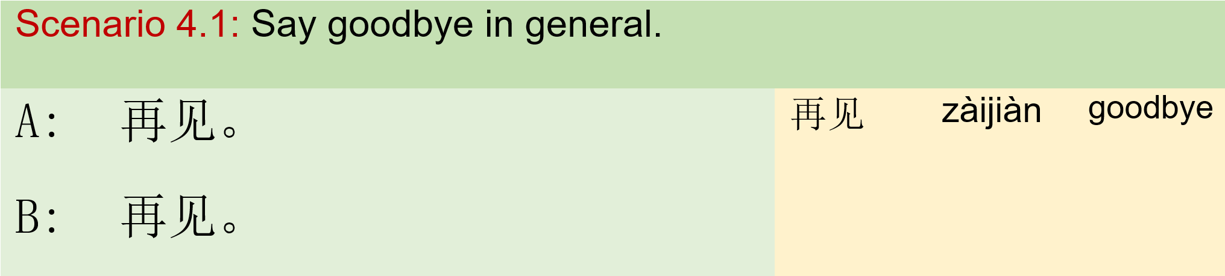
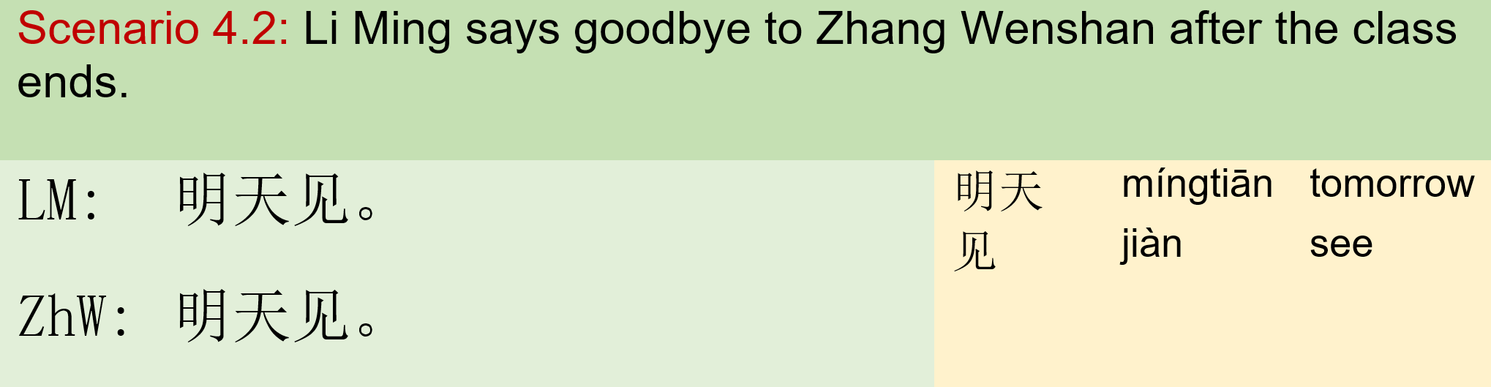
Module IV: Take leave 模块四：结束对话

Slide 19
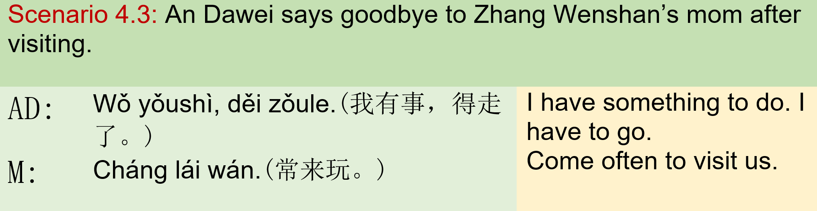
Module IV: Take leave 模块四：结束对话

Slide 20
Integration:
Communication:
- Tell someone your Chinese name. “我姓…, 我叫…，你可以叫我…” Text someone in our WeChat group to introduce yourself; respond with the appropriate greeting to the text message you received.

Slide 21
Integration
Communication
Choose one phrase from below and write it on a post-it sticker. 张叔叔、白阿姨、王老师、李先生、张文山、白叔叔、张老师、李阿姨、 李明、王老师的爱人、白阿姨的孩子、王先生、李女士、李明的老师 Put your sticker on someone’s back. Find a partner. Ask your partner questions in Chinese to find out what the phrase is on the sticker that you have. 我是…吗？ 我姓…吗？

Slide 22
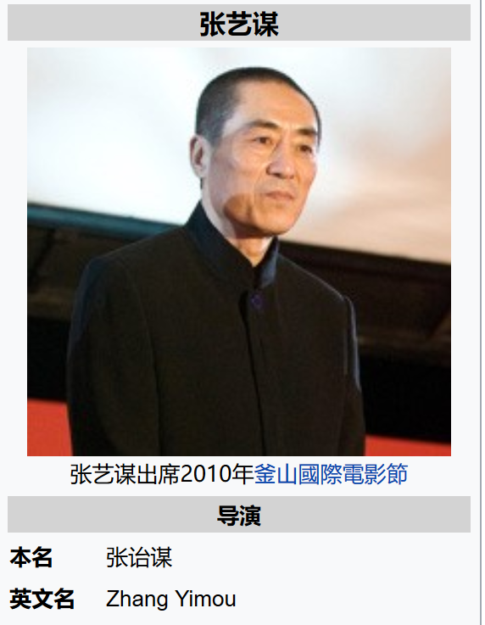
Integration
Who is this person?

Slide 23
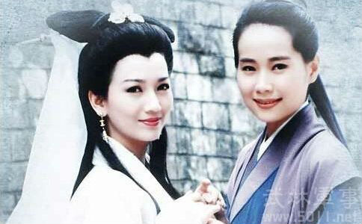
Integration
白素贞和许仙

Slide 24
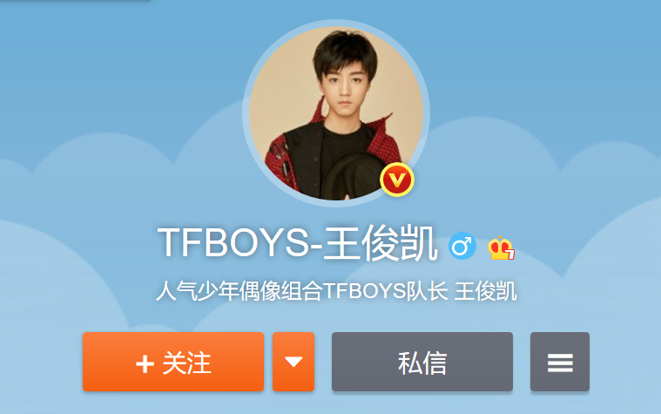
Integration

Slide 25
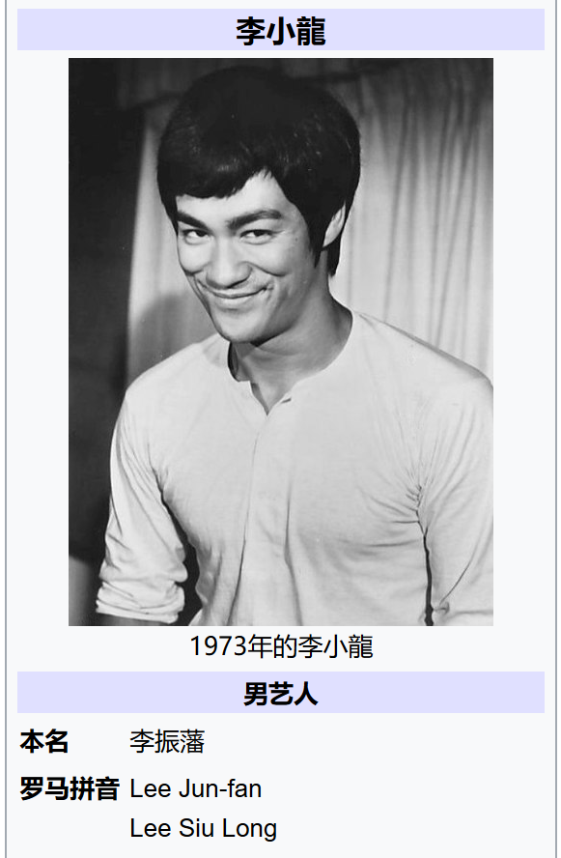
Integration
Who is this person?

Slide 26
Integration
Literacy:
Reading comprehension: Bruce Lee: Don't get set into one form, adapt it and build your own, and let it grow, be like water. Empty your mind, be formless, shapeless — like water. Now you put water in a cup, it becomes the cup; You put water into a bottle it becomes the bottle; You put it in a teapot it becomes the teapot. Now water can flow or it can crash. Be water, my friend. 老子（Laozi，Lao-tsu），姓李（名耳）。 “上善若水。”

Slide 27
Integration
Literacy:
上善若水。水善利万物而不争，处众人之所恶，故几于道。居，善地；心，善渊；与，善仁；言，善信；政，善治；事，善能；动，善时。夫唯不争，故无尤。 The highest good is like water. Water gives life to the ten thousand things and does not strive. It flows in places men reject and so is like the Tao. In dwelling, be close to the land. In meditation, go deep in the heart. In dealing with others, be gentle and kind. In speech, be true. In ruling, be just. In business, be competent. In action, watch the timing. No fight: No blame.

